Slide 1
LDA
Rakib Mahmud

Slide 2
Introduction
Linear Discriminant Analysis (LDA) is a supervised machine learning algorithm primarily used for dimensionality reduction and classification tasks.
The goal is to find a linear combination of features that maximizes the separation between different classes while minimizing the spread (variance) within each class.
Maximizing mean difference.
Minimizing within-class scatter

Slide 3
LDA (Steps)
Compute the class means of dependent variable
Derive the covariance matrix of the class variable
Compute the within class scatter matrix
Compute the between class scatter matrix
Compute the eigenvalues and eigenvectors from the within class and between class scatter matrix
Sort the eigenvalues and select the top k values

Slide 4
LDA (Steps) (Cont’d)
Find the eigenvectors corresponding to the top k eigenvectors
Obtain the LDA by taking the dot product of eigenvectors and original data

Slide 5
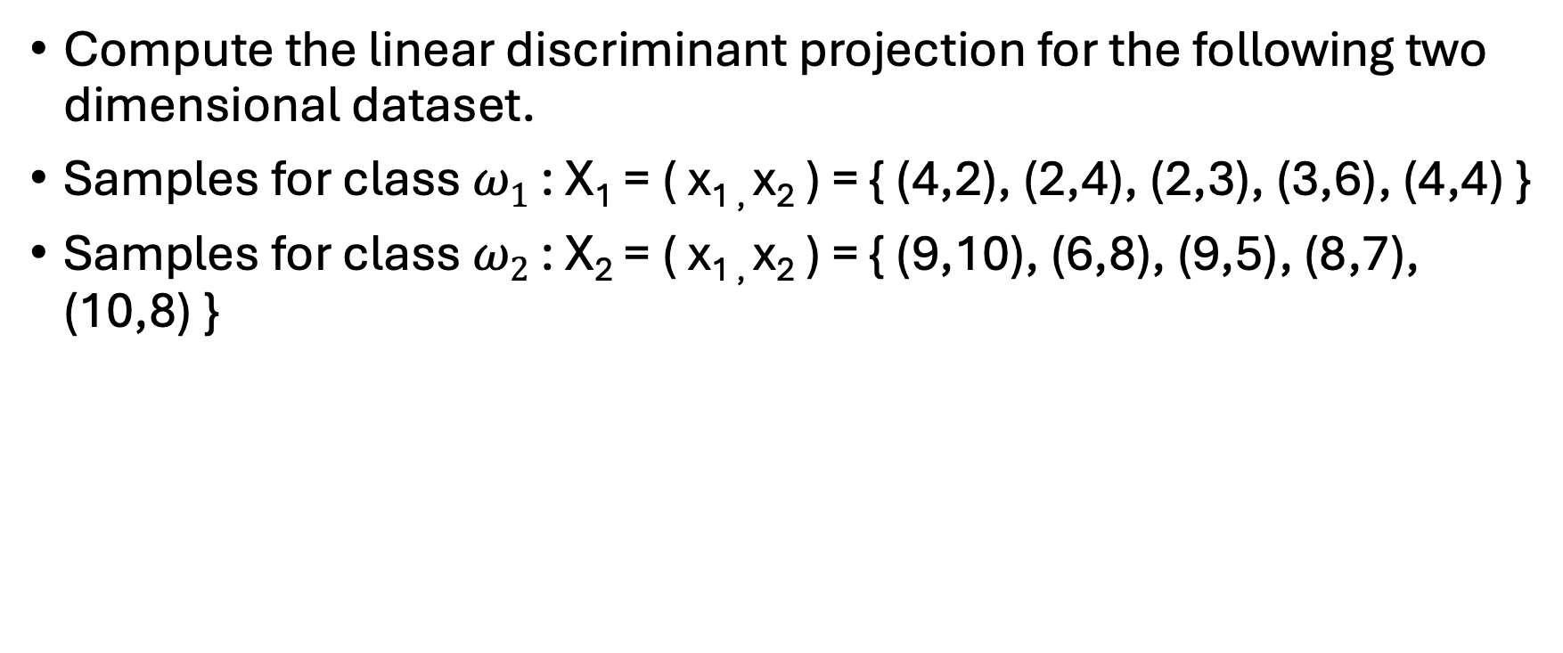
Math 1
Compute the linear discriminant projection for the following two dimensional dataset.
Samples for class $ω1$ : X₁ = ( x_{1 ,} x₂ ) = { (4,2), (2,4), (2,3), (3,6), (4,4) }
Samples for class $ω2$ : X₂ = ( x_{1 ,} x₂ ) = { (9,10), (6,8), (9,5), (8,7), (10,8) }

Slide 6
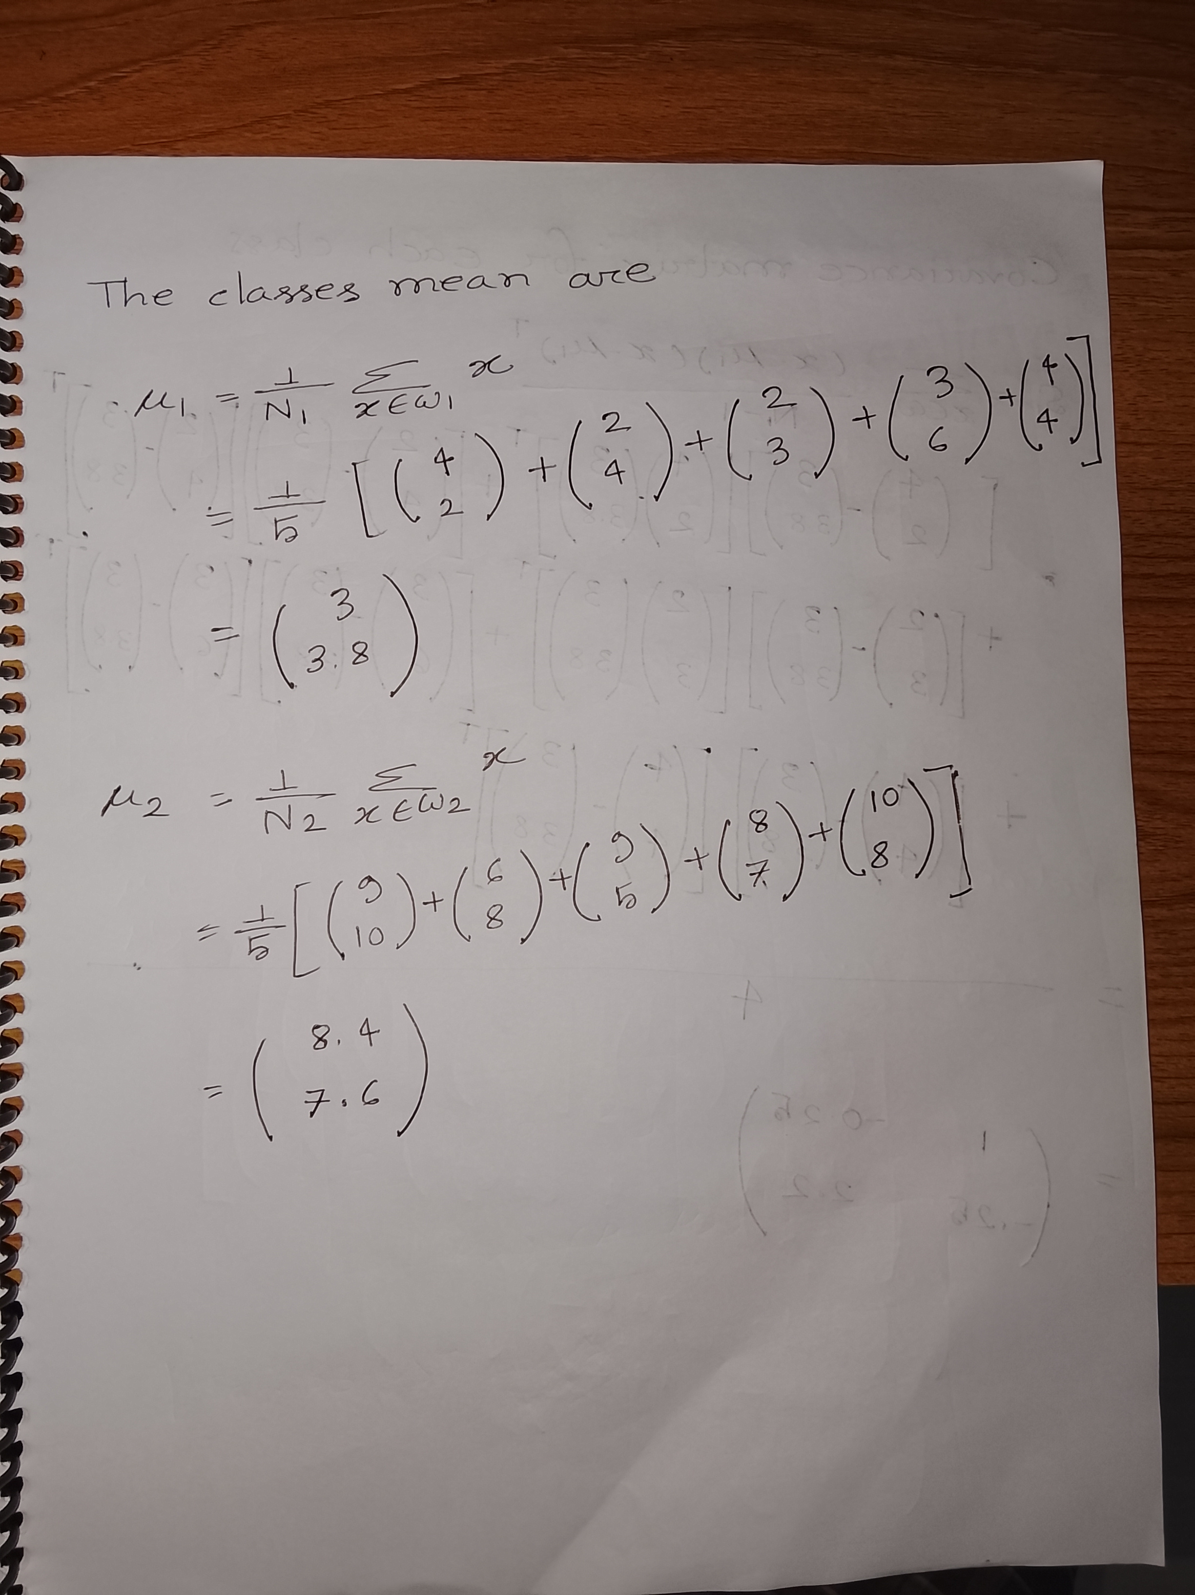
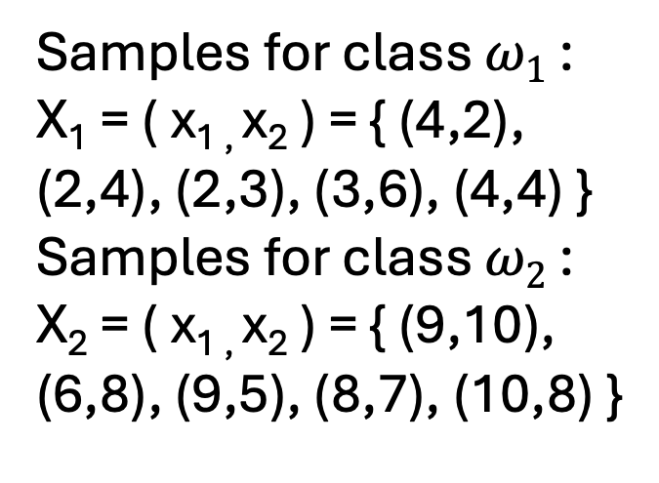
Samples for class $ω1$ : X₁ = ( x_{1 ,} x₂ ) = { (4,2), (2,4), (2,3), (3,6), (4,4) }
Samples for class $ω2$ : X₂ = ( x_{1 ,} x₂ ) = { (9,10), (6,8), (9,5), (8,7), (10,8) }

Slide 7
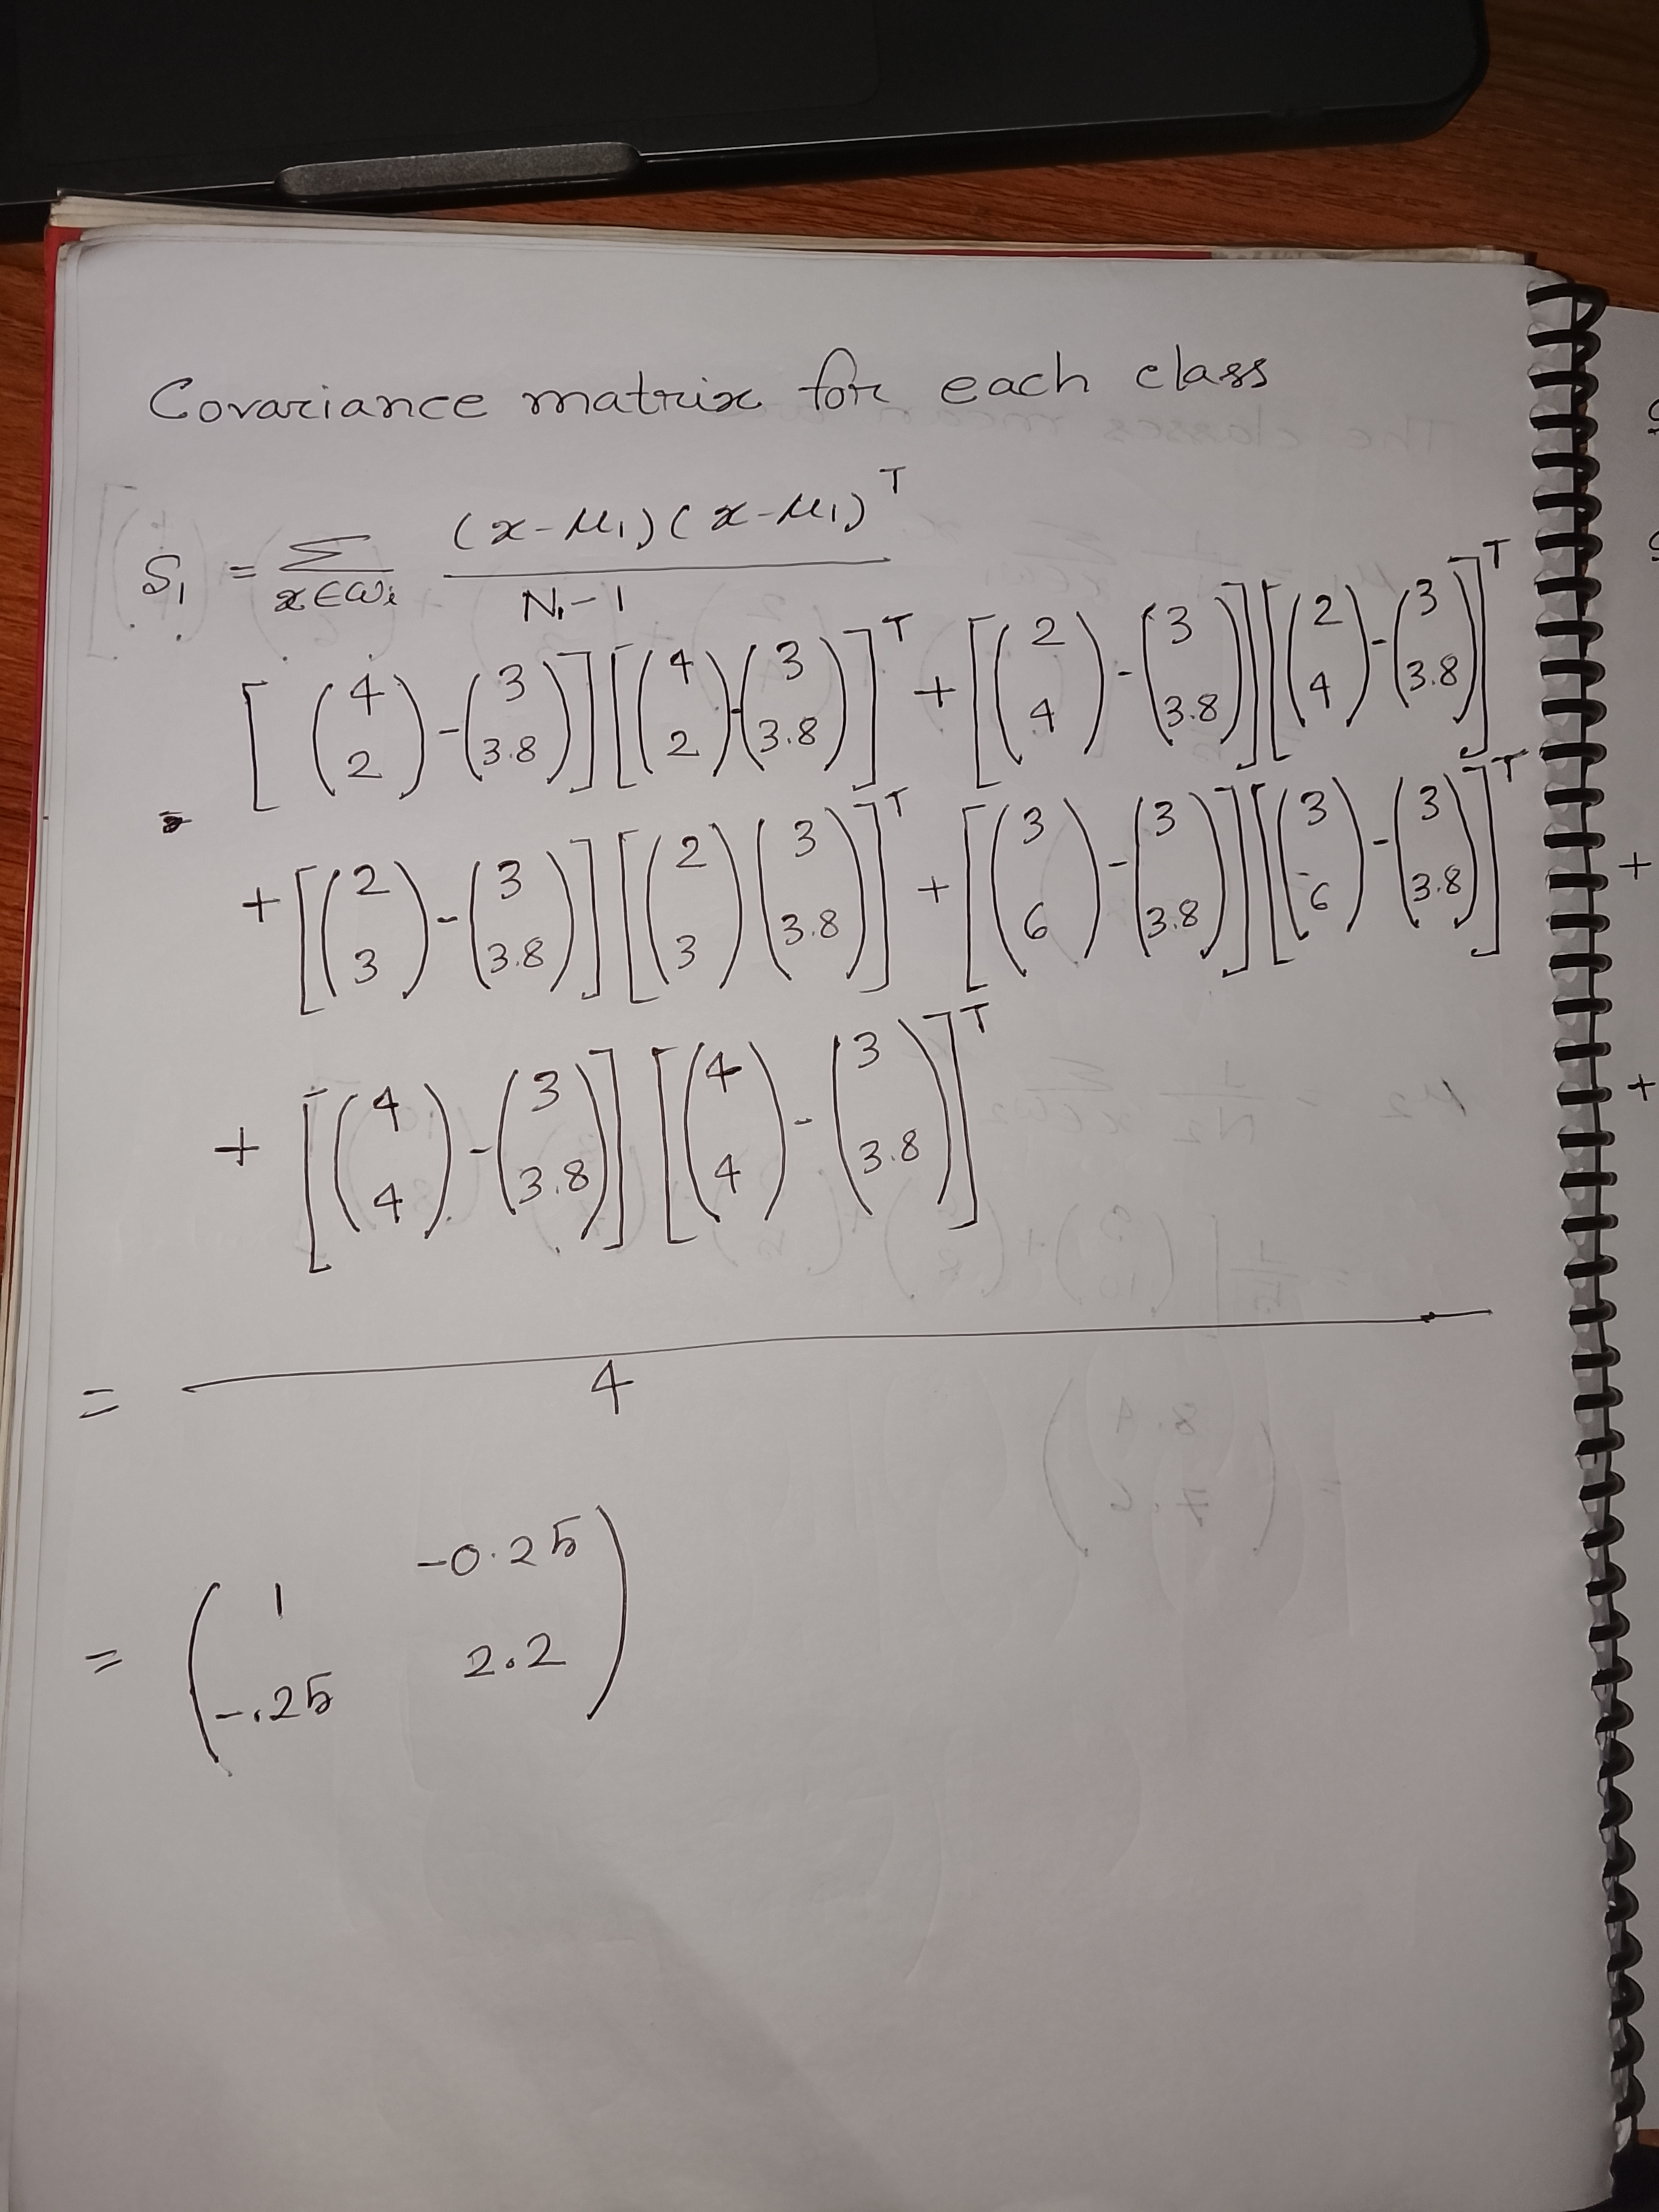
Samples for class $ω1$ : X₁ = ( x_{1 ,} x₂ ) = { (4,2), (2,4), (2,3), (3,6), (4,4) }
Samples for class $ω2$ : X₂ = ( x_{1 ,} x₂ ) = { (9,10), (6,8), (9,5), (8,7), (10,8) }

Slide 8
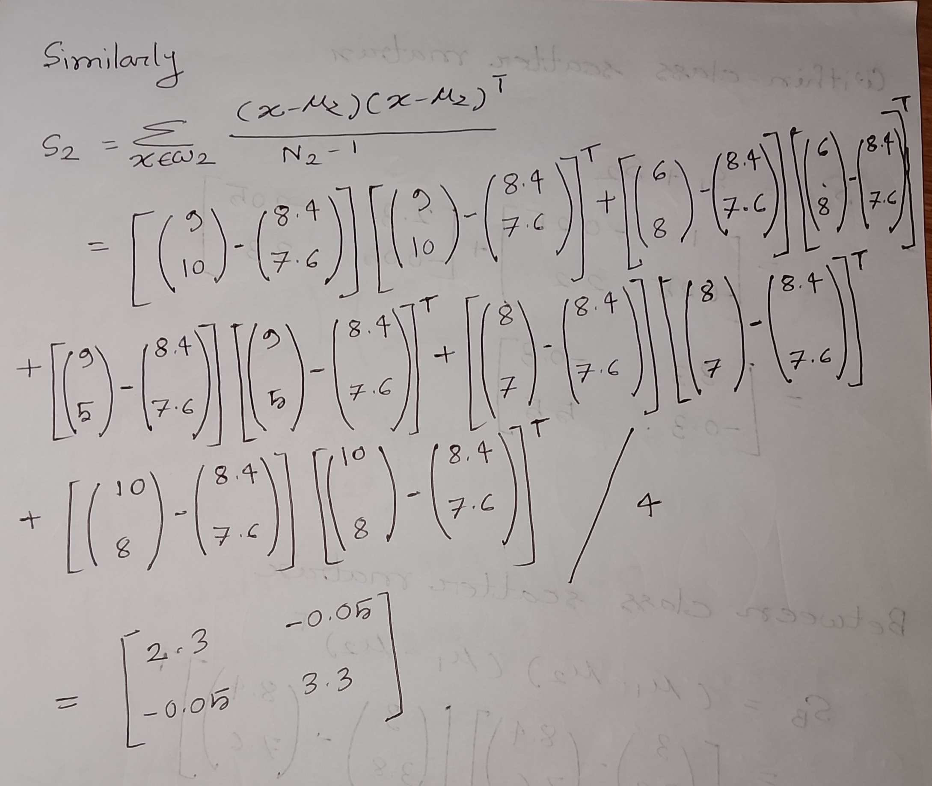
Samples for class $ω1$ : X₁ = ( x_{1 ,} x₂ ) = { (4,2), (2,4), (2,3), (3,6), (4,4) }
Samples for class $ω2$ : X₂ = ( x_{1 ,} x₂ ) = { (9,10), (6,8), (9,5), (8,7), (10,8) }

Slide 9
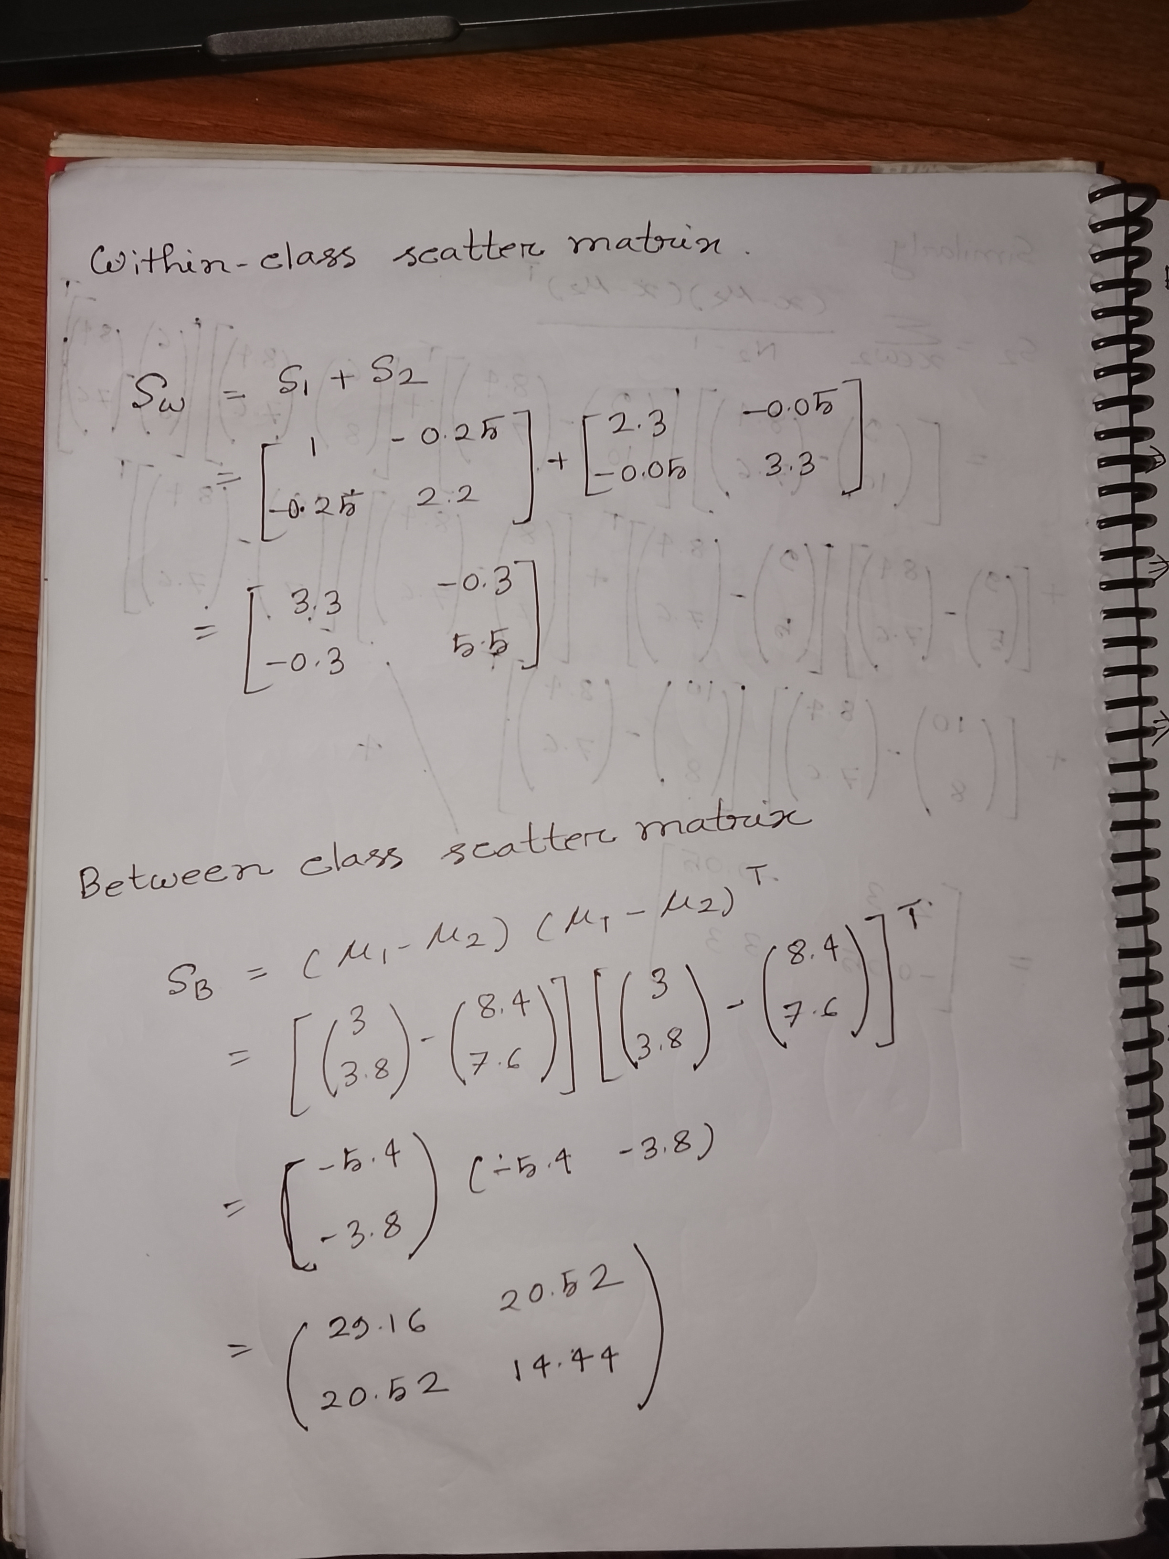

Slide 10
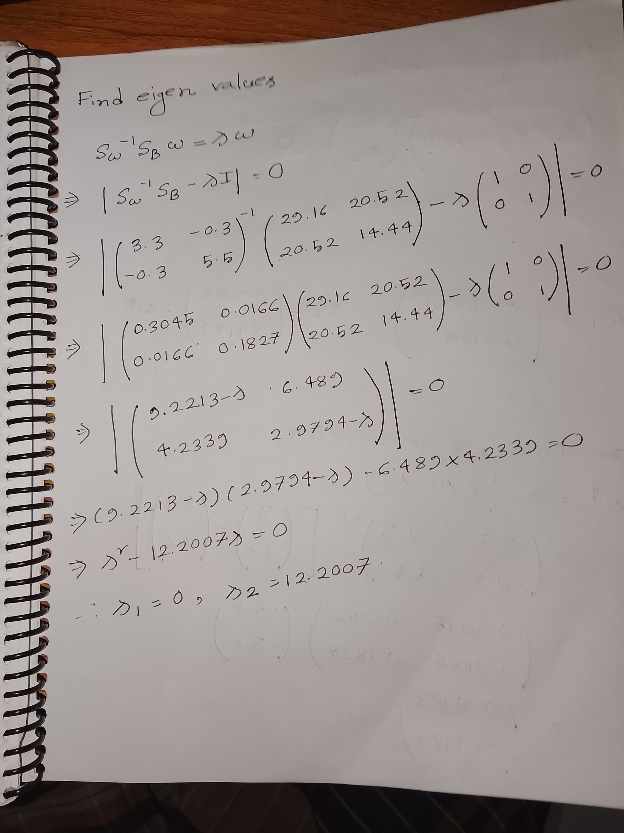

Slide 11
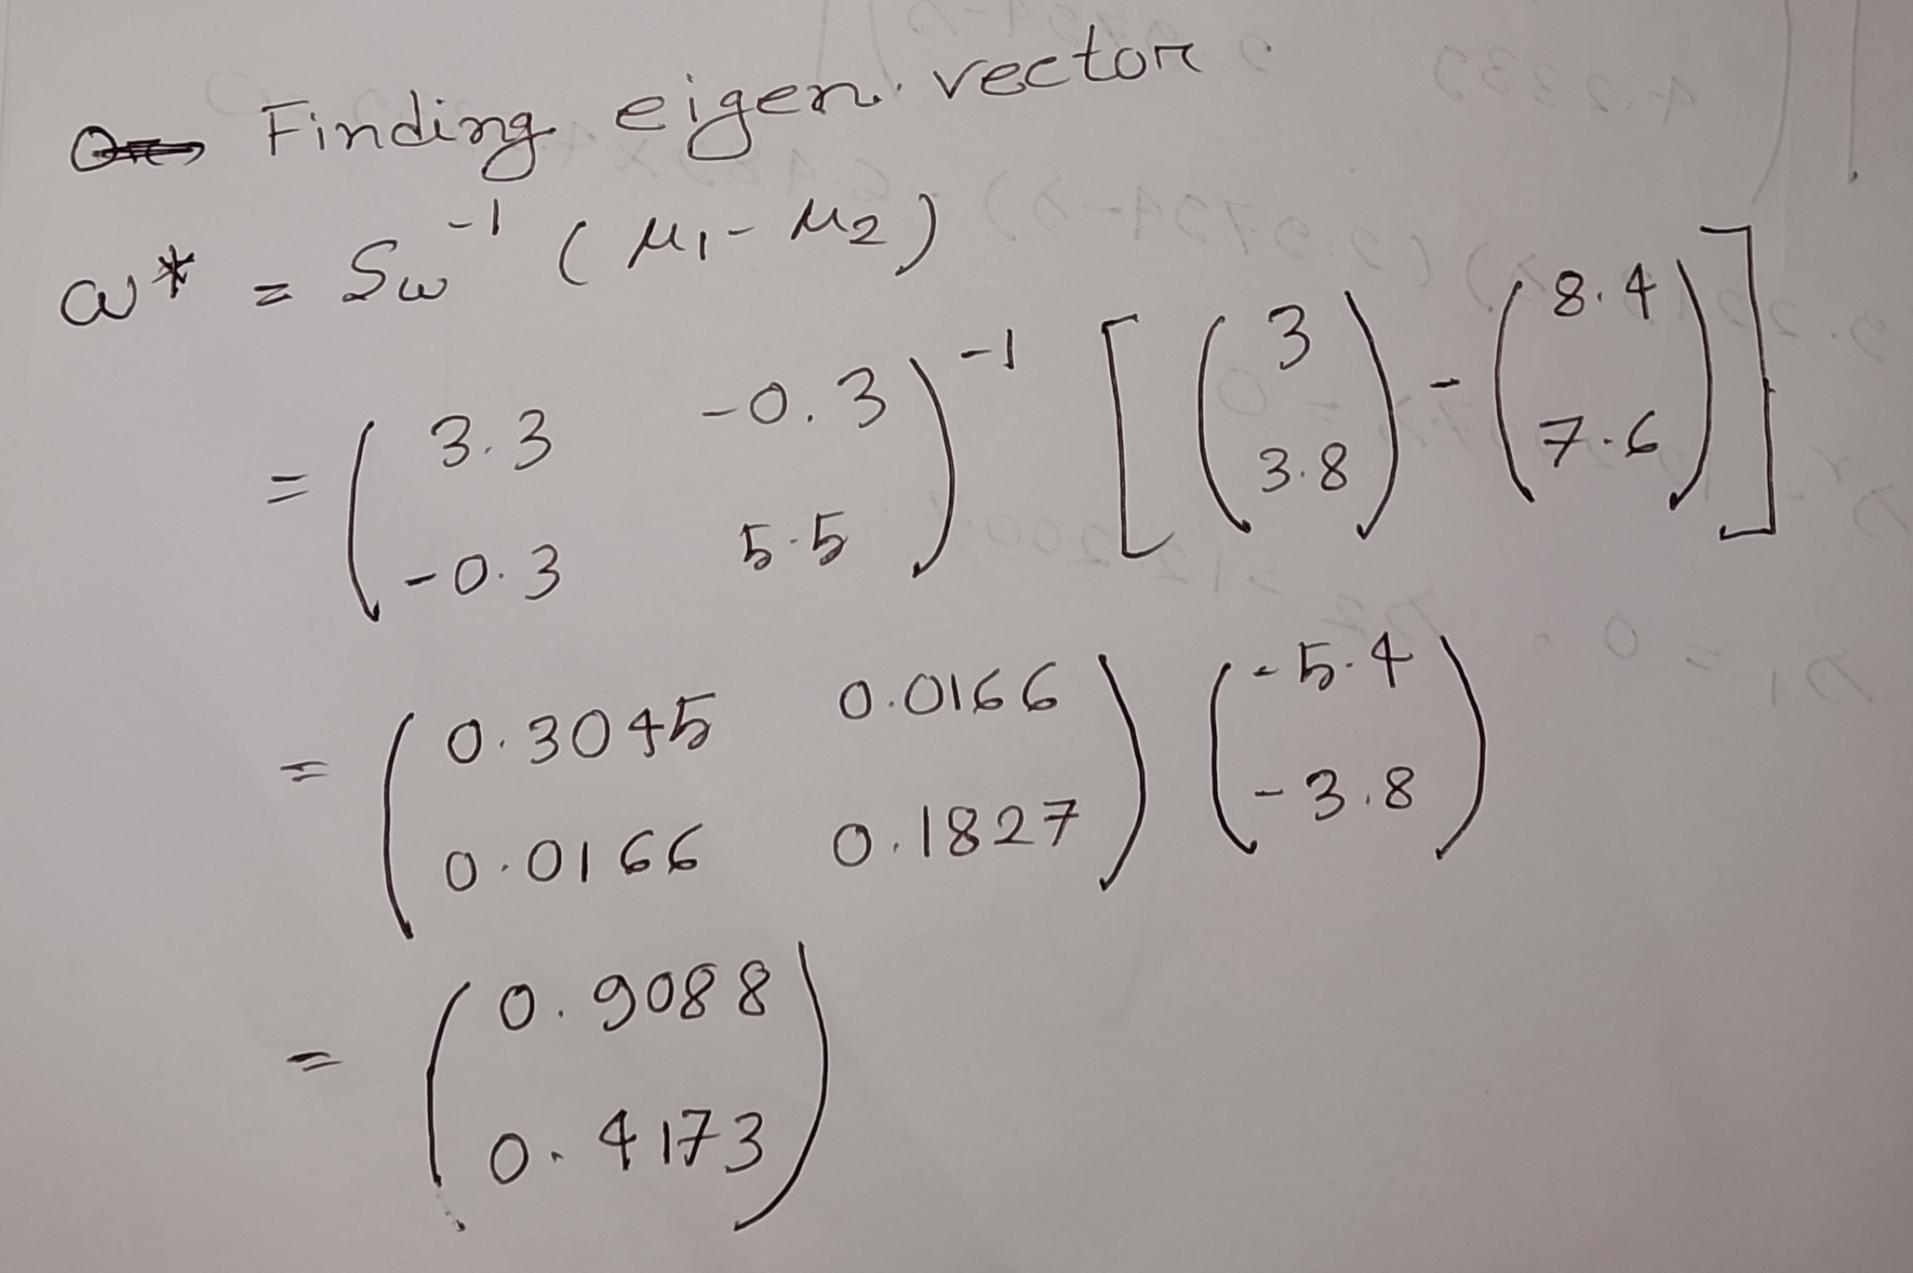

Slide 12
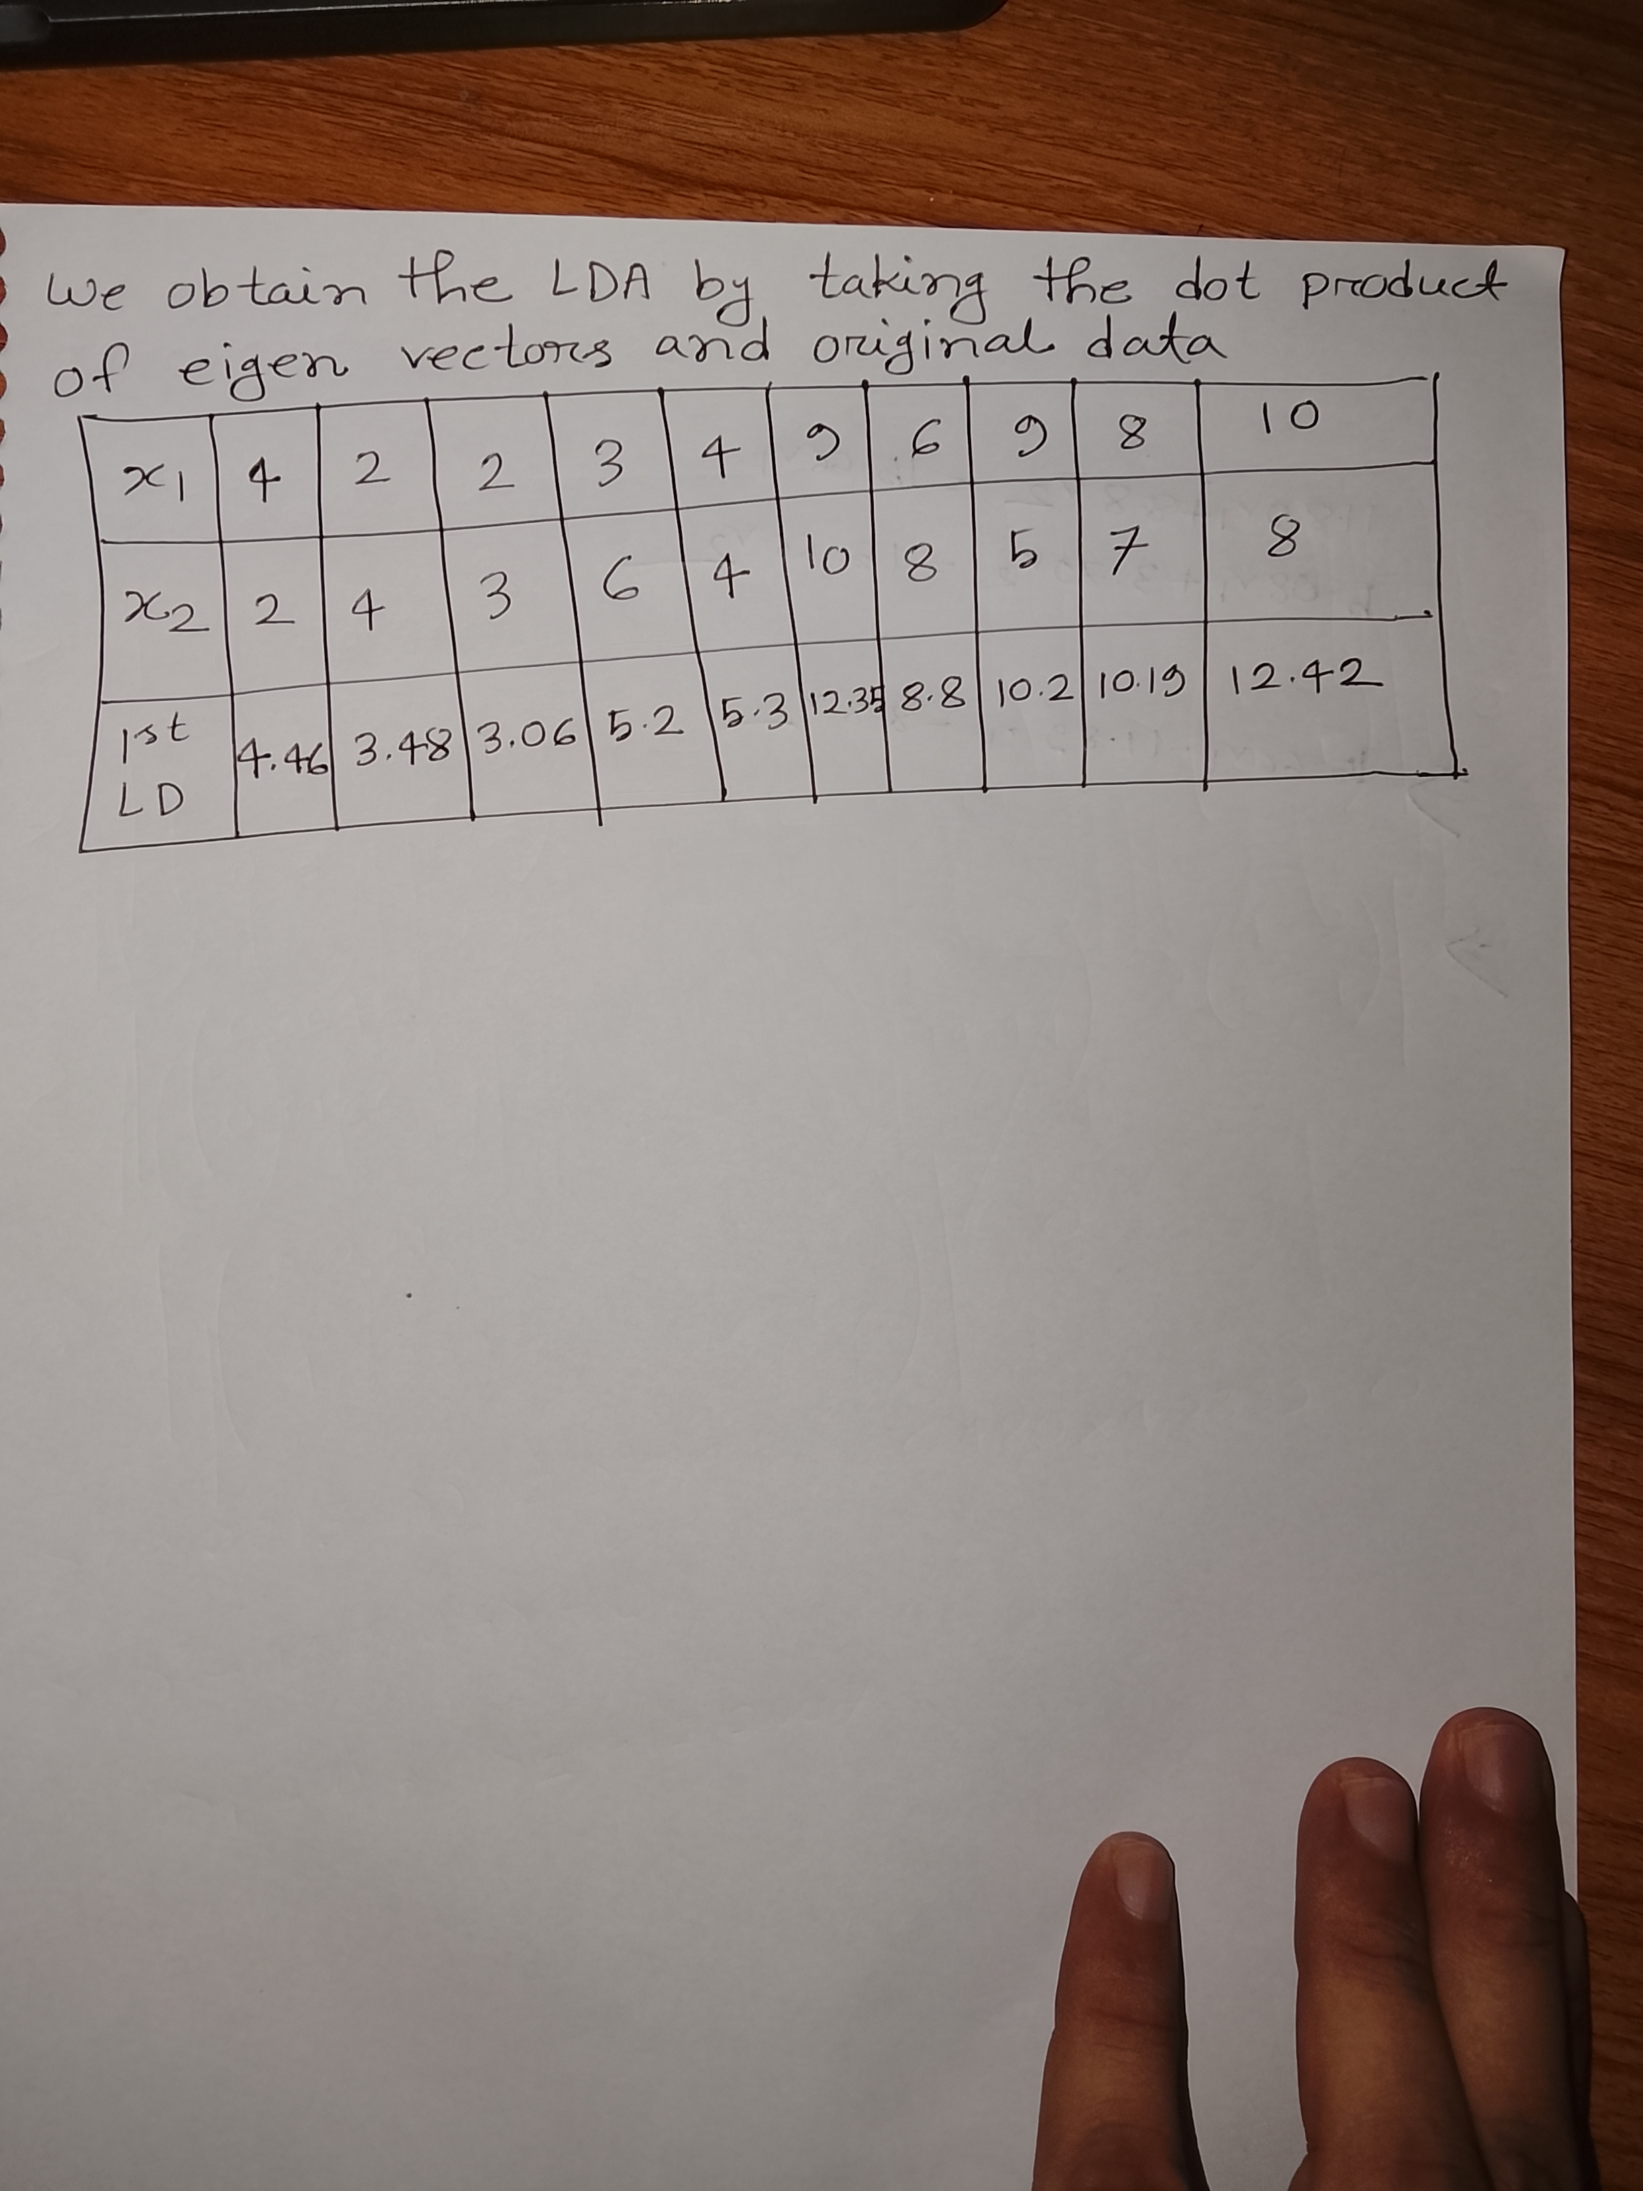

Slide 13
Thank You

